Slide 1

Rockbuster Video
Chris Anthony

Slide 2
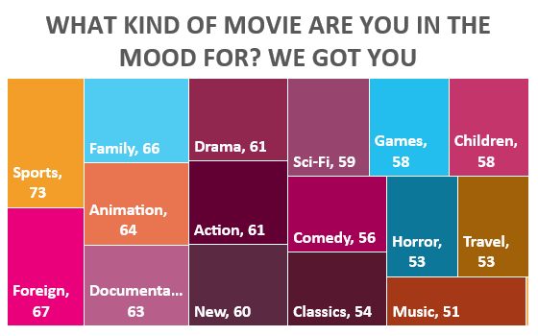
Our Library
Top 5 by Revenue
Title | Revenue
Telegraph Voyage | $215.75
Zorro Ark | $199.72
Wife Turn | $198.73
Innocent Usual | $191.74
Hustler Party | $190.78
Most Rented
Title | Times Rented
Bucket Brotherhood | 34
Rocketeer Mother | 33
Grit Clockwork | 32
Forward Temple | 32
Juggler Hardly | 32
With more than 1000 titles in our library covering 17 genres, we WILL have something in stock that will keep you Rocking.

Slide 3
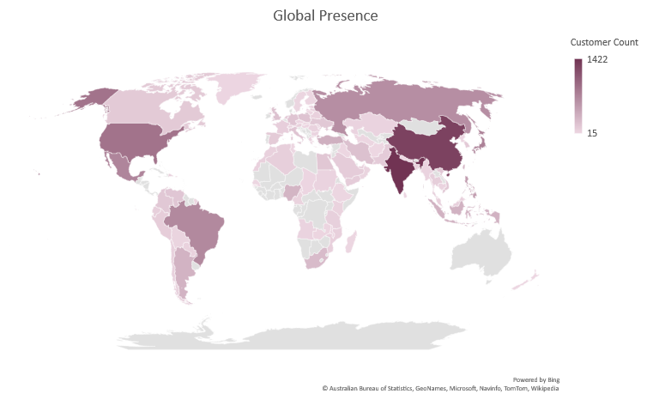
Our Clients
Country | Customer Count
India | 1422
China | 1297
United States | 869
Japan | 749
Mexico | 718
More than 14,500 customers located all over the globe and growing. There’s no hard place to find a Rock.

Slide 4
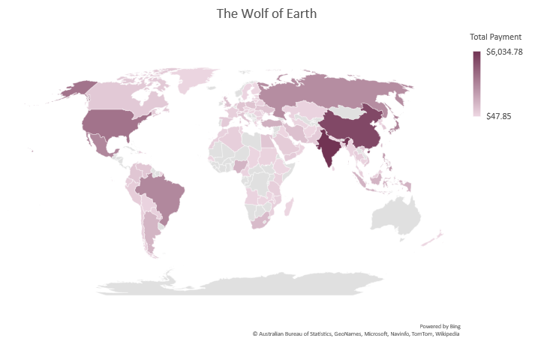
Our Revenue
In the last quarter alone, our revenue exceeded $61,000 and we processed 14,596 rentals. As our library grows, so does our revenue.
Country | Total Payment
India | $ 6,034.78
China | $ 5,251.03
United States | $ 3,685.31
Japan | $ 3,122.51
Mexico | $ 2,984.82

Slide 5
Behind the Scenes
Average Rental Transaction = $4.20
Our Brightest Stars
Most Frequent Actors
Tableau Workbook
Name | City | Total
Eleanor Hunt | Saint-Denis | $ 211.55
Karl Seal | Cape Coral | $ 208.58
Marion Snyder | Santa Brbara dOeste | $ 194.61
Rhonda Kennedy | Apeldoorn | $ 191.62
Clara Shaw | Molodetno | $ 189.60
Actor | Number of Appearances
Susan Davis | 54
Gina Degeneres | 42
Walter Torn | 41
Mary Keitel | 40
Matthew Carrey | 39

